Slide 1


Slide 2
Level of Integration (SSI, MSI, LSI)
This is comprehensive introduction to integrated circuit technologies, including SSI, MSI, LSI, VLSI, ULSI, and GSI. They are marked by the level of integration, which is mainly the number of transistors integrated.
CIT ,2 YEAR-A ELT-2

Slide 3
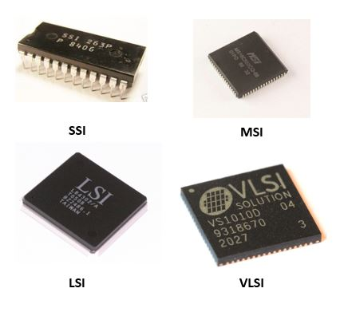
Level of Integration (SSI, MSI, LSI,VLSI.)
CIT ,2 YEAR-A ELT-2

Slide 4
Small Scale Integration (SSI)
Small scale integration is the earliest form of IC technology, integrating 1 to 100 transistors on a chip. It enables basic electrical functions, and some common applications are basic logic gates, operational amplifiers, and flip-flops.
CIT ,2 YEAR-A ELT-2

Slide 5
2. Medium Scale Integration (MSI)
Medium scale integration incorporates 100-1000 transistors on a single IC chip. Some of its applications are multiplexers (MUX), counters, adders, and 4-bit microprocessors.
CIT ,2 YEAR-A ELT-2

Slide 6
3. Large Scale Integration (LSI)
Large scale integration is a revolutionary step in IC technologies by accommodating 1000 to 10000 transistors on an IC chip. This IC technology enables more advanced components, like 8-bit microprocessors, ROM (read-only memories), and RAM (random-access memories).
CIT ,2 YEAR-A ELT-2

